Slide 1
Lesson 7 Applications of DSP
任课教师：刘昱朗
Email: yulangliu@hotmail.com

Slide 2
Outline
Technical Contents
Digital Signal Processing 数字信号处理
Digital Signal Processors 数字信号处理器
Applications of DSP
Technical Terms

Slide 3
Digital Signal Processing
Digital signal processing (DSP) is the use of digital processing, such as by computers or more specialized digital signal processors, to perform a wide variety of signal processing operations. The signals processed in this manner are a sequence of numbers that represent samples of a continuous variable in a domain such as time, space, or frequency.

Slide 4
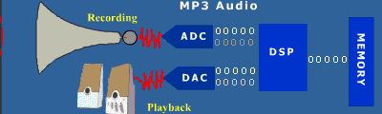
Digital Signal Processor
What is a DSP (Digital Signal Processor)?
DSPs are processors or microcomputers whose hardware, software, and instruction sets are optimized for high-speed numeric processing applications­, an essential for processing digital data representing analog signals in real time.

Slide 5
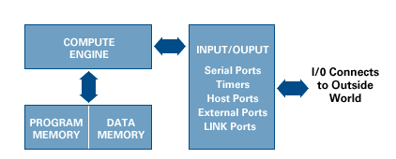
Digital Signal Processor
Program Memory
Data Memory
Compute Engine
Input/output

Slide 6
Digital Signal Processor
Advantages
DSP offers very high accuracy.
The digital implementation is cheaper compare to analog counterpart.
In DSP reconfiguration is very easy and only code or DSP program need to be flashed after changes are incorporated as per requirements.
The DSP offers various interface types.
High-speed

Slide 7
Digital Signal Processor
Disadvantages
Moreover it requires extra modules. Due to use of this extra components complex of DSP based hardware increases.
Most of the DSP chips are very costly and hence one needs to use the appropriate IC as per requirements ( hardware, software ).
Power Consumption

Slide 8
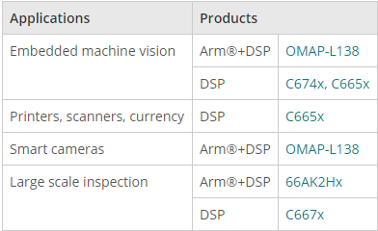

Applications of DSP (TI)
Machine vision

Slide 9
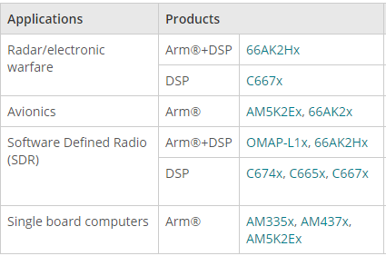
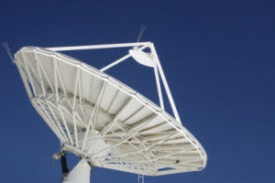
Applications of DSP (TI)
Avionics and defense

Slide 10
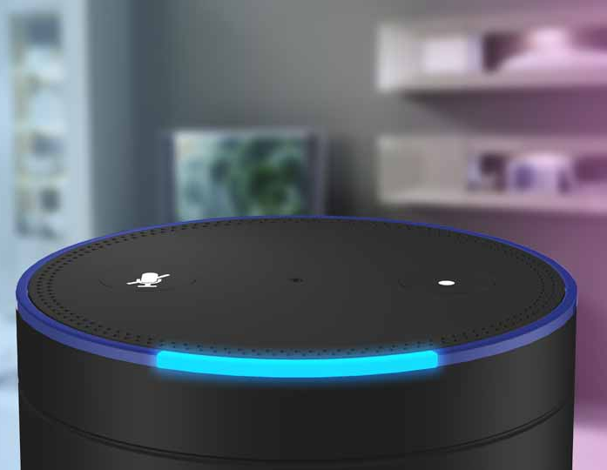
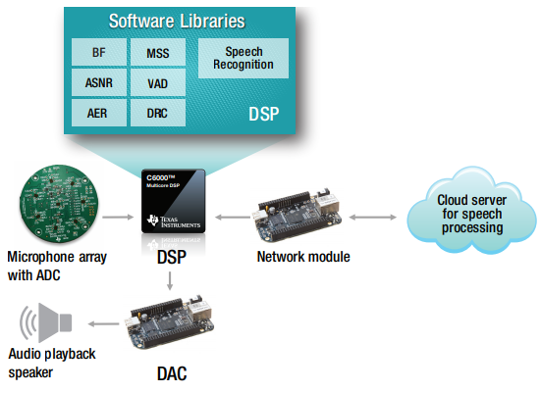
Applications of DSP (TI)
Audio

Slide 11

Applications of DSP (TI)
Video encoding/decoding
H.265 (Encode/Decode)
H.264 BP/HP (Encode/Decode)
H.264 MP (Decode)
MPEG4 (Encode/Decode)
MPEG2 (Encode/Decode)
JPEG (Encode/Decode)
JPEG2000 (Encode/Decode)
AVC Intra/Ultra (Encode)

Slide 12
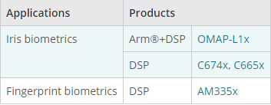

Applications of DSP (TI)
Biometrics

Slide 13

Applications of DSP (GOODiX)

Slide 14
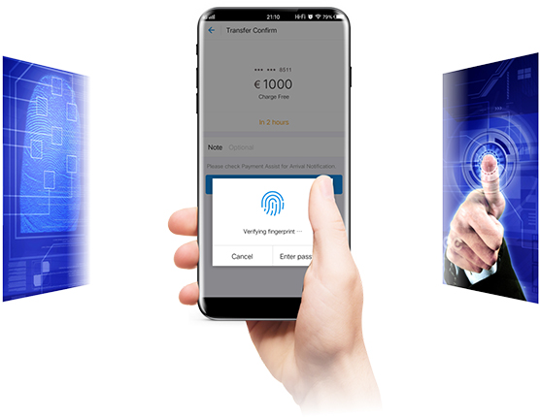
Applications of DSP (GOODiX)
Remarkable stability under extreme conditions (temperature, humidity, and etc.)
Original Lamination Solution
Won 2017 COMPUTEX d&i awards
Commercialized on flagship models from HUAWEI, OPPO, vivo, Xiaomi, Honor, OnePlus, Redmi, ZTE, MEIZU, Lenovo, Moto, iQOO, realme, BlackShark, etc.

Slide 15
Applications of DSP (ADI)

Slide 16
Applications of DSP (ADI)

Slide 17
Applications of DSP (ADI)

Slide 18
Applications of DSP (ADI)

Slide 19
Technical Terms
Numerical 数值的
Proportion 比例
Infinite 无限的
Simultaneously 同时
Iterative 迭代的
Compatibility 兼容性
Aliasing 混叠
Digitization 数值化

Slide 20
Technical Terms
Baseband 基带
Spectrum 频谱
Undersampling 欠采样
Real time 实时
Simulation 仿真
Nyquist Theorem 奈奎斯特定理
Full scale range 满量程
SNR signal to noise ratio 信噪比
Power dissipation 功耗

Slide 21
Technical Terms
Multiplier 乘法器
Accumulator 累加器
Shifter 位移器
Parallel Architecture 并行结构
Ripple 纹波
Data compression 数据压缩
Cutoff frequency 截止频率
PCB printed circuit board 印刷电路板
CAD computer aid design 计算机辅助设计

